Slide 1
HARNESSING THE POWER OF ENGINEERED MACROPHAGES
CARISMA Therapeutics
January 2022

Slide 2



Harnessing the Power of Engineered Macrophages
CARISMA is a private, clinical stage, vertically integrated biotech company developing our first-in-class CAR-M technology for advanced cancers and other diseases
Proprietary Platform and Capabilities
First-in-Class CAR-M Pipeline
Solid tumor targets (HER2, Meso, PSMA) in development
Lead program CT-0508 (HER2) currently enrolling patients in Phase I clinical study (NCT04660929)
Rationally selected heme malignancy targets
Non-oncology applications (liver fibrosis, neurodegeneration, and auto-immunity)
Myeloid Specific Cell Engineering
Proprietary Vectors
Gene Editing Capabilities
Experienced Leadership and Focused Strategy
Deep research, clinical and operational expertise in cell and gene therapy and oncology
Capital efficient discovery, manufacturing and development program to rapidly establish human safety and proof of concept
Broad scope of research and process development initiatives allowing optionality and scalability as we advance the pipeline
Auto/Allo
Cell Source
Cell & Vector Manufacturing
Significant IP
~$200M Raised To Date

Slide 3
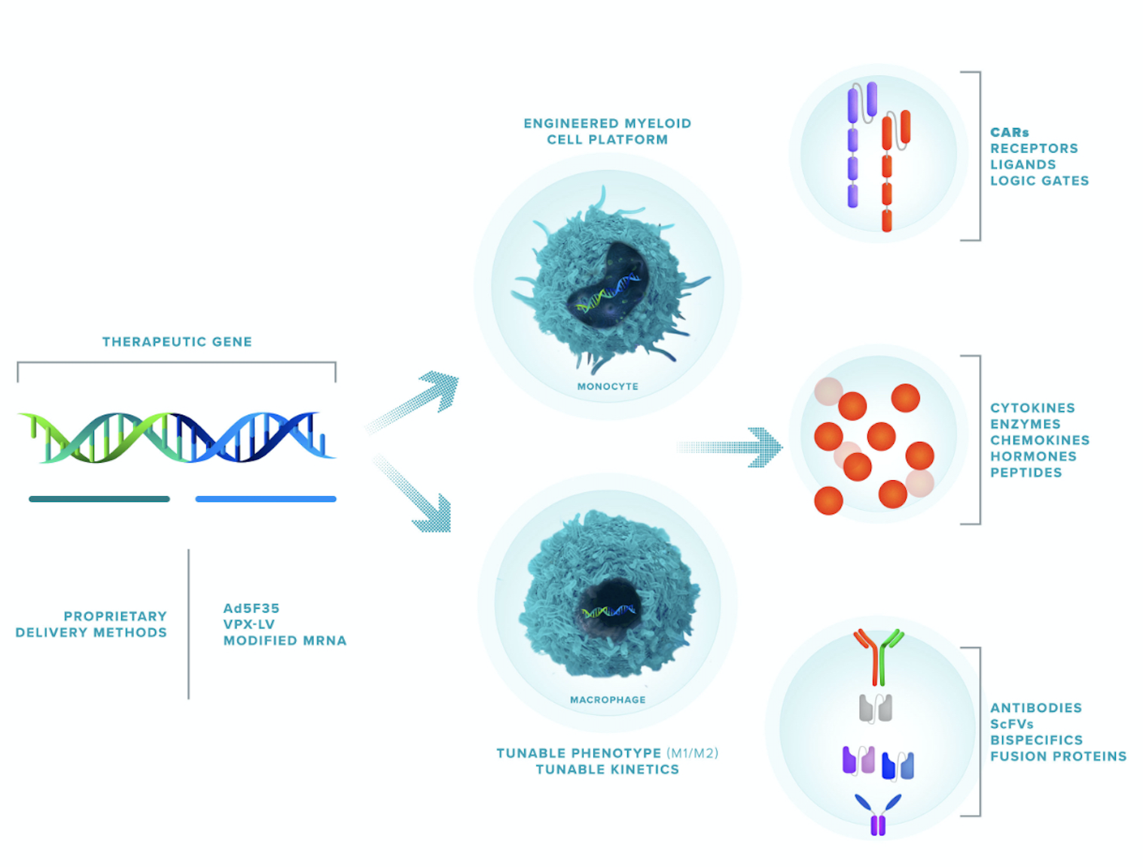
CARISMA’s Broad Myeloid Cell Engineering Platform
Monocyte & Macrophage Engineering Capabilities:
Proprietary platforms for durable macrophage engineering with Ad5f35 and Vpx-LV
Proprietary platform for transient macrophage engineering: Modified mRNA
Methods to control macrophage phenotype toward M1 & M2
Ability to deliver large/multiplexed payloads
Efficient gene editing methods using CRISPR/Cas9
CRISPR-Cas9
Proprietary technology, world-leading macrophage engineering know-how, and strong IP position ensure leadership position

Slide 4
Pre-clinical data demonstrates that CAR-M induce a multi-factorial attack on solid tumors
TRAFFICKING AND PHAGOCYTOSIS
IMMUNE ACTIVATION
ANTIGEN PRESENTATION
Target cell

Slide 5
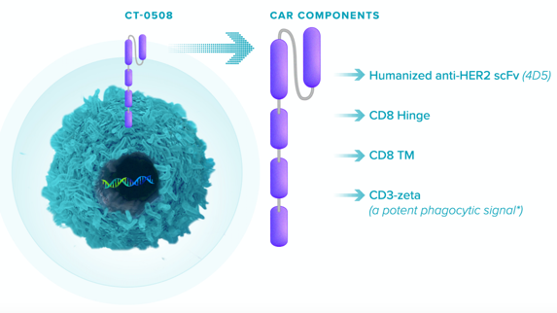
Lead Program CT-0508: HER2 Targeted CAR-Macrophage
Program Status
Phase I study ongoing with four clinical sites open for screening & enrollment
Early data read supports platform’s safety and MOA
Future Milestones
Goal of enrolling up to two patients/month for a total of 18 patients – Enrollment complete mid-’22
Preliminary data presentation at SITC ‘21 / Expanded data presentation mid-’22
Expanded clinical program including regional administration and T cell checkpoint combination
Cells: Autologous monocyte derived macrophages
Vector: Ad5f35
Phenotype: M1
Target: HER2
FDA Fast Track Designation Granted Sept 2021

Slide 6



Phase I First-In-Human Multicenter Open Label Study
18 patients with recurrent/metastatic HER2+ overexpressing solid tumors
G-CSF mobilization and apheresis
CAR-M manufacture, bridging therapy
Baseline staging
Study Objectives
Primary Safety Manufacture feasibility
Secondary Cell kinetics OR (RECIST 1.1) OS and PFS
Correlates Phenotype Bioactivity Immune cell interaction
CT-0508 infusion
No preparative chemotherapy
CT-0508
Week 1
Week 4
Week 8
Week 52
Tumor biopsy (Pre Treatment)
Tumor biopsy
(Post treatment)
Tumor biopsy
(Post treatment)
RECIST v1.1

Slide 7
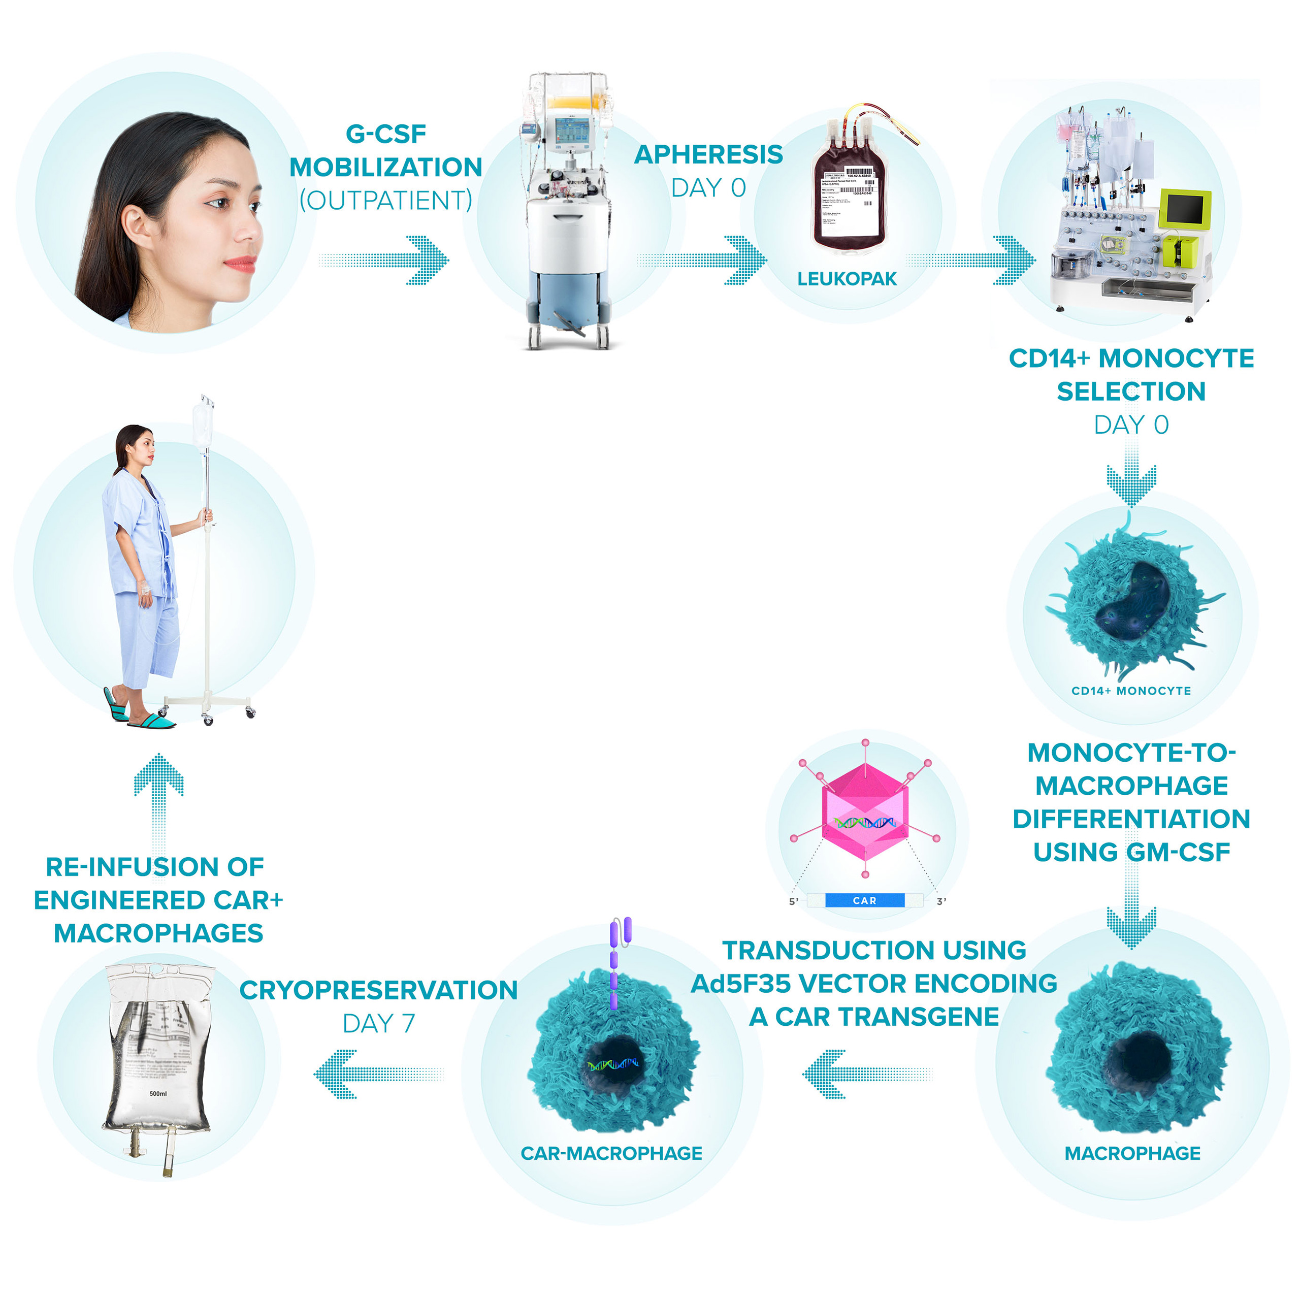

CT-0508 Manufacturing Process
Source: Autologous mobilized peripheral blood
Manufacturing time: 1 week
Vein to vein: 3 weeks
Vector: Ad5f35
Process: Automated
Fill: Cryopreserved

Slide 8
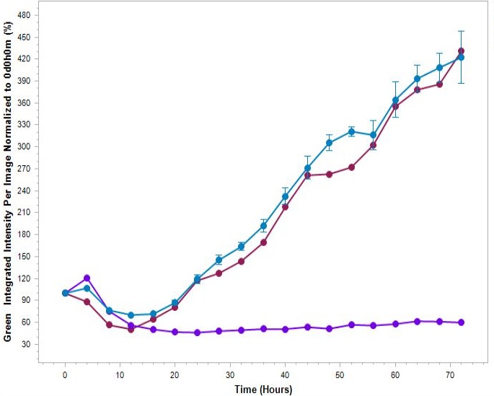
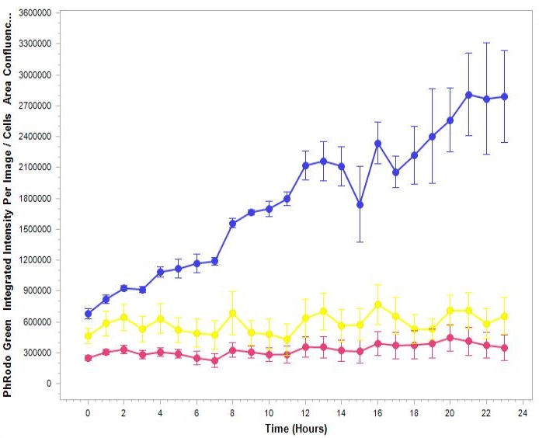
CT-0508 CAR-M Manufacturing: Functional M1 Polarized CAR Macrophages Generated
Efficient HER2+ Tumor Killing
CT-0508 Immunophenotyping: M1 Phenotype
Tumor alone
M1 Markers
UTD-M
86.7%
93.3%
Tumor cell burden
CT-0508
Efficient HER2+ Tumor Phagocytosis
M2 Markers
CT-0508
91.7%
Phagocytic Index
Tumor alone
UTD-M
Note: Killing / phagocytosis / Immunophenotyping assays from 1 representative run.

Slide 9
Summary of treated patients
Heavily pre-treated patients with advanced/metastatic HER2+ solid tumors
Subject number | Subject 1 | Subject 2
Demographics | Male, 72yo | Female, 68yo
Tumor type | Esophageal adenocarcinoma, poorly differentiated | Extrahepatic cholangiocarcinoma
HER2 | IHC 2+, ISH positive | IHC 3+
Tumor status | Metastatic: lymph nodes, bone | Metastatic: lung and lymph nodes
Prior therapies | FOLFOX + trastuzumab → trastuzumab maintenance Palliative Radiation therapy Pembrolizumab | Surgery: partial whipple FOLFOX FOLFIRI + trastuzumab
Dose Limiting Toxicities | None | None

Slide 10
CT-0508 Was Well Tolerated With No Dose Limiting Toxicities
AEs with a start date on or after the first dose of CT-0508:
Majority of AEs were Grade 1
No AEs leading to CT-0508 dose modification or discontinuation
1 CRS Grade 2 on D3, characterized by fever and hypotension, resolved same day with acetaminophen, cefepime and fluids
1 SAE of Upper GI Hemorrhage 88 days after last CT-0508 infusion, deemed unrelated to therapy
AE Term | Grade* | DLT | SAE
Abdominal pain | 1 | No | No
Back pain | 1 | No | No
Concentration impairment | 1 | No | No
Cytokine release syndrome | 2 | No | No
Diarrhea | 1 | No | No
Dysgeusia | 1 | No | No
Hoarseness | 1 | No | No
Hypertension | 1 | No | No
Hypotension | 1 | No | No
Lymphocyte count decreased | 3 | No | No
Paresthesia | 2 | No | No
Platelet count decreased | 1 | No | No
Pruritis | 1 | No | No
Upper GI hemorrhage | 4 | No | Yes
Urinary retention | 2 | No | No
White blood cell count decreased | 2 | No | No
Worsening anemia | 3 | No | No
Worsening lymphocyte count decrease | 3 | No | No
* Worst Grade reported
Notes:
(script not needed)

Slide 11
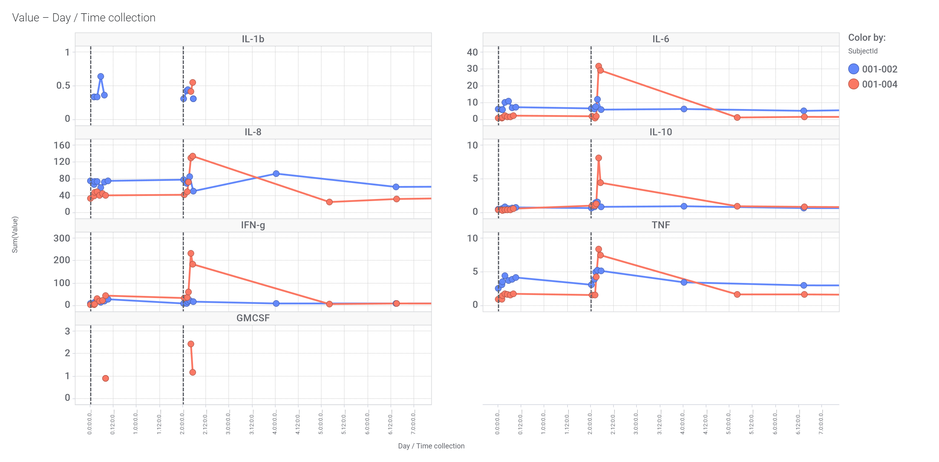
CT-0508 Leads to Transient Elevations of Pro-Inflammatory Cytokines in Peripheral Blood
Subject:
Subject 1
Day 1 – Pre-infusion
Day 3 – Pre-infusion
Day 1 – Pre-infusion
Day 3 – Pre-infusion
Subject 2
Day 1 – Pre-infusion
Day 3 – Pre-infusion
Day 1 – Pre-infusion
Day 3 – Pre-infusion
Serum concentration (pg/mL)
Day 1 – Pre-infusion
Day 3 – Pre-infusion
Day 1 – Pre-infusion
Day 3 – Pre-infusion
Day 1
Day 3
Day 5
Day 8
Day 1
Day 3
Day 5
Day 8
Severe CRS is characterized by sustained increased of these factors, commonly starting several days after infusion.
All cytokine elevations were transient, self-limiting, and peaked acutely (2-4 hours) post each infusion.

Slide 12
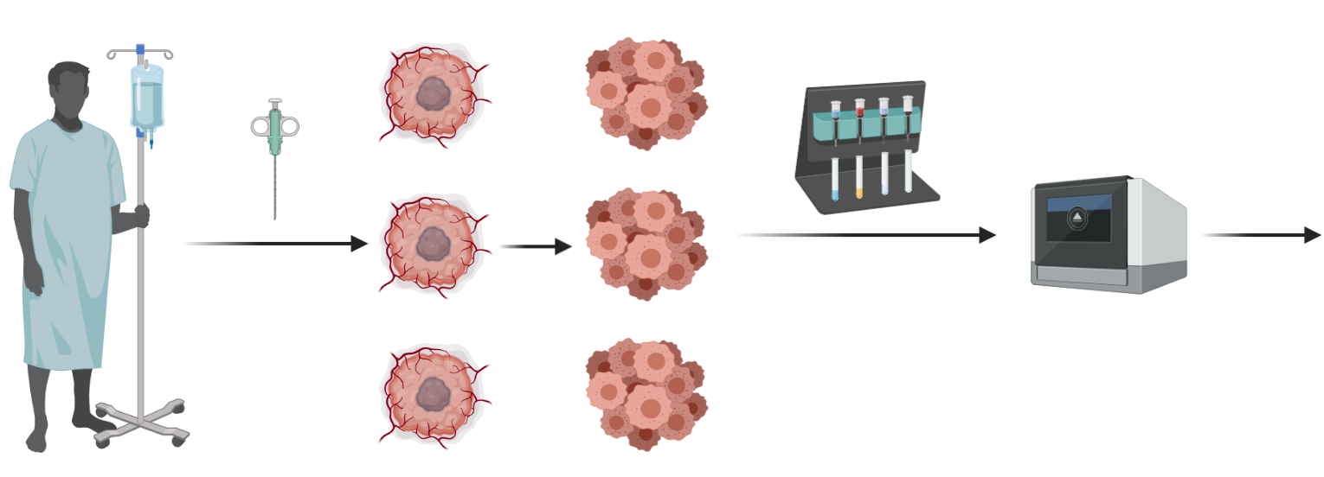
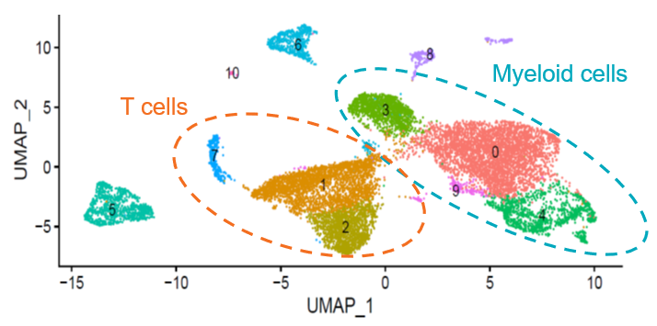
Tumor Microenvironment Analysis Using Single Cell RNAseq
Fresh biopsy material
Single cell
suspension
10x Genomics
Single cell RNA seq
Subject 1 CD45⁺ TME clustering:
screening
screening
Core needle biopsy
CD45+ selection
Day 8
Day 8
Week 4
Week 4

Slide 13
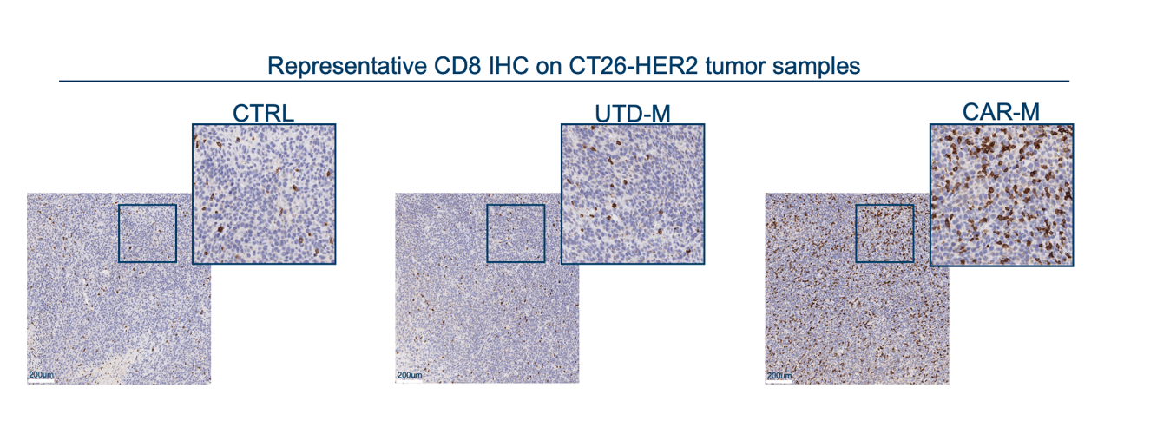
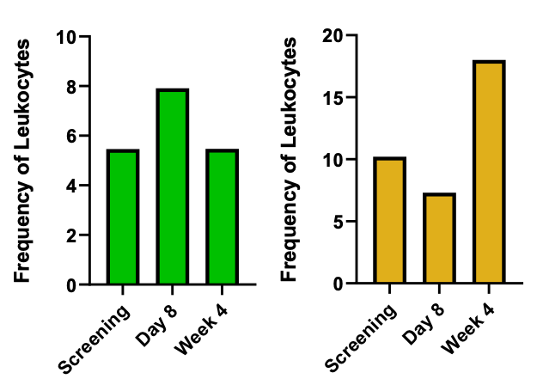
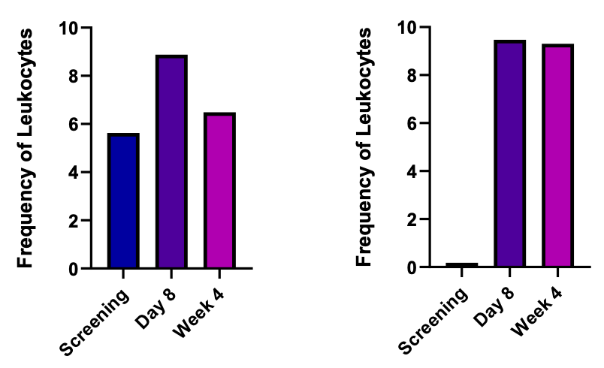
CT-0508 induces CD8 T cell tumor infiltration and activation
Pre-clinical data in murine solid tumor models:
Clinical data demonstrates CD8 T cell infiltration and activation in the solid TME:
CAR-M modulate the TME – CD8+ T cell infiltration and activation
Naïve CD8+
T cells
Activated Effector
CD8+ T cells
Patient 1:
Patient 2:
Patient 1: HER2 2+ esophageal cancer
Patient 2: HER2 3+ cholangiocarcinoma

Slide 14
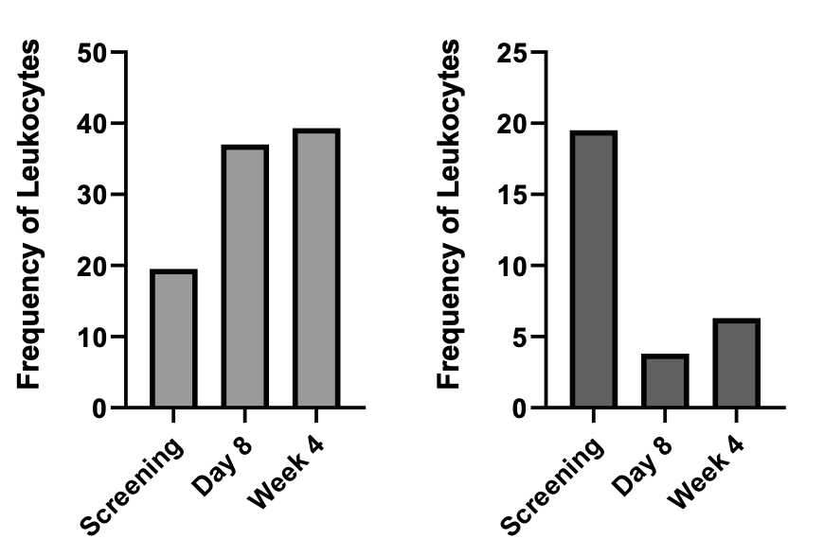
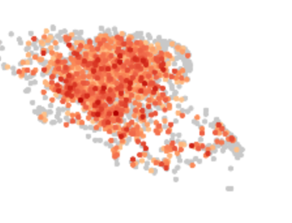
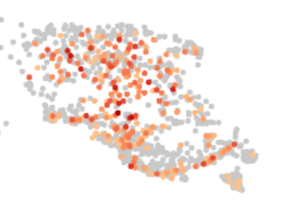
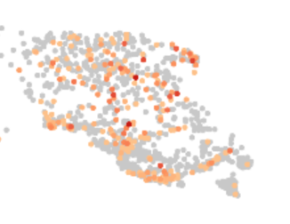
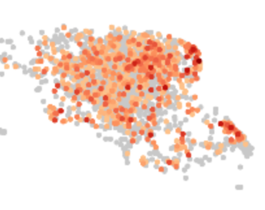
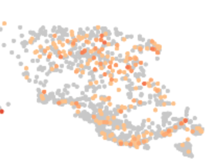
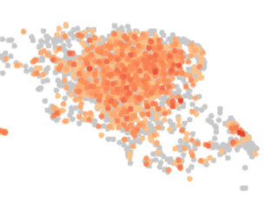
CT-0508 Remodels the Myeloid Compartment in the TME
Patient 1 TME demonstrates increase in pro-inflammatory myeloid cells and decrease in tumor resident macrophages:
Activation of intratumoral myeloid cells in Patient 1 TME:
Inflammatory Monocytic Cells
Tumor Resident Macrophages
Pre-treatment
biopsy
Week 4
biopsy
IL6
TNFa
Inflammatory Monocytic Cells
ISG20
Tumor Resident Macrophages
M2
M1

Slide 15
Initial CT-0508 Phase I Data
Preliminary dataset available from extensive correlative studies
Objectives
Manufacturing
Safety
PK
Biomarkers
TME Activation
Adaptive Immune Response
  CT-0508 cell product was generated successfully, showing high CAR expression, high viability, high purity, M1 phenotype, and good in vitro anti-tumor function
No significant treatment related adverse events
No dose-limiting toxicities
CT-0508 infusion​ was well tolerated
Short persistence of CT-0508 in the blood (~4-6 hours) consistent with rapid migration to tissue
  Serum cytokines and chemokines were only transiently increased following infusion and rapidly normalized to baseline levels
  Single cell transcriptomic analysis of tumor infiltrating leukocytes demonstrated pro-inflammatory remodeling of the myeloid compartment and a significant enrichment/ activation of tumor reactive CD8⁺ T cells
T cell repertoire analysis in the blood demonstrated initiation of an adaptive immune response

Slide 16
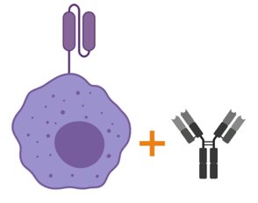
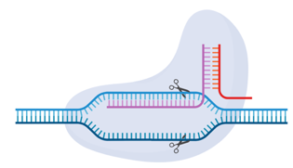

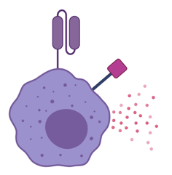

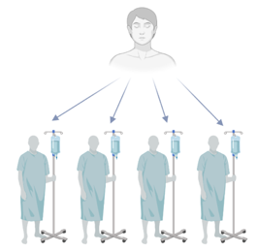
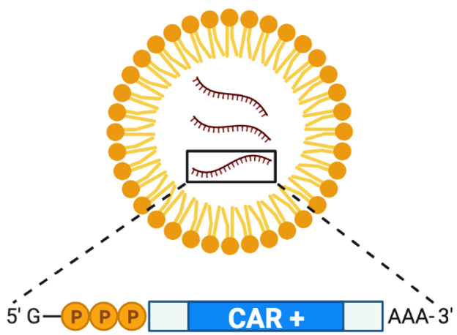
Robust R&D Program Driving Platform Enhancements
Platform Enhancements
Combination
therapies
Gene edited
CAR-M
Novel CAR
designs
Immune Activator Delivery
Novel Modalities:
CAR
Monocytes
Allogeneic
Myeloid Cells
In Vivo
mRNA CAR-M

Slide 17
Robust R&D Program Driving Platform Enhancements
Platform Enhancements
Combination
therapies
Gene edited
CAR-M
Novel CAR
designs
Immune Activator Delivery
Novel Modalities:
CAR
Monocytes
Allogeneic
Myeloid Cells
In Vivo
mRNA CAR-M

Slide 18
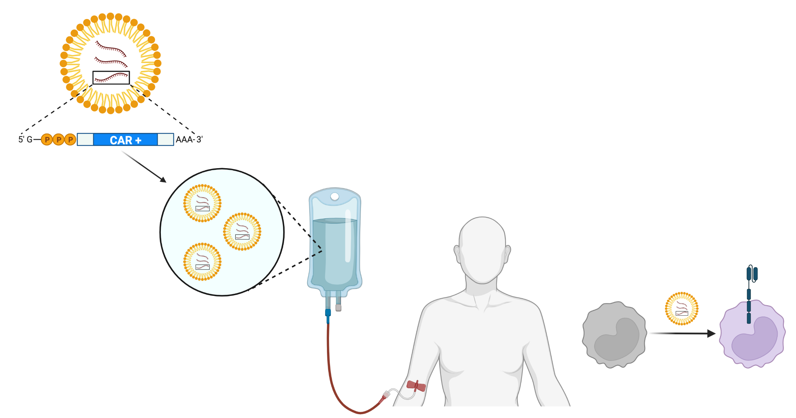
A novel modality: in vivo CAR-M therapies
LNP/mRNA based gene therapy
Myeloid tropic LNP + CAR mRNA
In vivo administration
In vivo generated CAR-M

Slide 19


Combining Two Pioneering Companies’ Core Technologies to Develop Breakthrough in vivo CAR-M for Cancer
CAR-M Pioneers
mRNA Pioneers
Establish a first-in-class mRNA based in vivo CAR-M platform for oncology
Develop up to 12 targeted in vivo CAR-M therapeutics

Slide 20
Partnership Description
Multi-year research collaboration funded by Moderna with options for up to twelve targets
Carisma to receive $45 million up-front cash payment and investment by Moderna in the form of a $35 million convertible note
Moderna providing R&D funding
Carisma eligible to receive significant program milestone and royalty payments

Slide 21

CARISMA’s Engineered Macrophage Platform
Ex vivo Cell Therapy
Autologous
Allogeneic
In vivo Delivery
Oncology
Solid Tumors
Hematologic Malignancy
Non-Oncology
Liver Fibrosis
Neurodegeneration
Autoimmune

Slide 22

Powering the Engine of Next-Generation Cell Therapies
Current Portfolio | Cell/Target | Indication | Route | Discovery | Preclinical | Phase I | Partner
Cell Therapy
CT-0508 | Macrophage/ HER2 | Solid tumors | IV & IP
CT-0508 + pembrolizumab | Macrophage/ HER2 | Solid tumors | IV
CT-0508.1 | Monocyte/ HER2 | Solid tumors | IV
CT-1119 | Mesothelin | Solid tumors | multiple
CT-0729 | PSMA | mCRPC | IV
In vivo mRNA CAR-M
Partnership with Moderna | Up to 12 targets | Solid & heme oncology | IV
Non-Oncology
Liver Fibrosis | Undisclosed
Neurodegeneration | Undisclosed

Slide 23



Corporate Milestones
2021
SITC ‘21
n=2 Patients
ASCO ‘22
n=9 Patients
2022
SITC ‘22
n=18 Patients
Q3
Q4
Q1
Q2
Q3
Q4
Cohort 1 Enrollment n=9 Patients
Full Study Enrollment n=18 Patients
CT-0508: Phase I – Safety and Feasibility
CT-0508: Phase I – Intraperitoneal Administration
CT-0508: Phase I/II – Anti-PD-1 Combo
CAR-Mono: Phase I
Mesothelin Lead Nominated for IND enabling Development
PSMA Lead Nominated for IND enabling Development
Mesothelin IND Target Filing with FDA
Moderna Partnership Up to 12 Oncology Targets
In vivo CAR-M platform and pipeline

Slide 24


Corporate Summary
Proprietary Engineered Macrophage Platform
CARISMA is The Leader in Engineered Macrophage Technology with Broad Therapeutic Applications Including the Treatment of Solid Tumors
Emerging Pipeline of Oncology CAR-Ms
Established GMP Vein-to-vein Supply Chain
Experienced Leadership Team and Advisors
Multiple Value Catalysts over Next 12 Months

Slide 25
Thank you

Slide 26
















Strong Leadership Team and Advisors
Management
_{Steven Kelly}
_{President & CEO}
_{Dan Cushing, PhD}
_{CDTO}
_{Rich Morris}
_{CFO}
_{Debora Barton, MD}
_{CMO}
Michael Klichinsky, PharmD PhD
_{Co-Founder & SVP, Research}
_{Tom Wilton}
_{CBO}
Advisors
_{Saar Gill, MD PhD}
_{Co-Founder}
_{U Penn}
_{Carl June, MD}
_{University of Pennsylvania}
_{Hy Levitsky, MD}
Former CSO of Juno Therapeutics
_{Lisa Coussens, PhD}
_{Oregon Health &}
_{Science University}
_{Prasad Adusumilli, MD}
_{MSKCC}
_{Nina Bhardwaj, MD, PhD}
_{Mt. Sinai}
_{Nabil Ahmed, MD}
_{Baylor College}
_{of Medicine}
Board of Directors
_{Sanford Zweifach}
_{Chairman}
_{Briggs Morrison}
_{Independent}
_{Margarita Chavez}
_{AbbVie Ventures}
_{Jacob Gunterberg}
_{HealthCap}
_{Regina Hodits}
_{Wellington}
_{Chidozie Ugwumba}
_{Symbiosis}

Slide 27
CARISMA Pipeline
Product/Program | Discovery | Preclinical | IND Enabling | Phase I
Oncology
Ex Vivo Cell Therapy
CT-0508 (HER2 targeted CAR-Macrophage)
CT-0508.1 (HER2 targeted CAR-Monocyte)
CT-1119 (Mesothelin targeted CAR-Macrophage)
CT-0729 (PSMA targeted CAR-Macrophage)
In Vivo Targeted Delivery
Discovery and Development Partnership with Moderna (Up to 12 targets)
Non-Oncology
Ex Vivo Cell Therapy
Liver Fibrosis
Neurodegeneration

Slide 28
CAR-M + PD1 Blockade Leads to Improved Tumor Control and Survival in Immunocompetent Animals
Synergistic anti-tumor activity:
Synergistic TME modulation:
Groups | n | Subject Alive | Median Survival
CTRL | 18 | 0/18 | 40.5 days
CAR-M | 18 | 7/18 | 71 days
aPD-1 | 12 | 1/12 | 50 days
CAR-M + aPD-1 | 18 | 12/18 | Undefined

